Slide 1
Fault Detection in Factory Machines
190346A - Laksika T
190287R - Kajanan S
190277L - Jayaweera IGHI
190408R - Nanayakkara NKPI
Group - 03

Slide 2
Introduction
Predictive maintenance is vital in industry, preventing machine faults, minimizing downtime, and enhancing safety.
It's used in aviation, manufacturing, energy, transportation, and healthcare, ensuring efficiency and safety.
We aims to ensure continuous machinery operation and reduce risks associated with unplanned failures.
Objective: Create a specialized anomaly detection model for vibration data to improve operational efficiency and resource allocation.

Slide 3
Data Collection and Organization to Create a Combined Dataset
1

Slide 4
Introduction to Dataset
Two distinct datasets:
Vibration dataset: Contains vibration measurements of M2 recorded from 4 sensors. [It might contain noise of other 20 machines]
Machine status dataset: Used 3 sensors to capture 21 machines’ status at 1 min time interval. [Sensor 1 - M1 to M5, Sensor 2 - M6 to M13, Sensor 3 - M14 to M21]
Organized on a weekly basis, with each week comprising two essential data sources.
Vibration measurements:
"OAVelocity", "Peakmg", "RMSmg", "Kurtosis", "CrestFactor", "Skewness", "Deviation", "PeaktoPeakDisplacement" are in X, Y, and Z directions.
Expectation: Earlier Fault Detection for Machine 2

Slide 5
Dataset Preprocessing
Handling Missing Values
Duplicate Management
Enhance Data Interpretation

Slide 6
Dataset Preprocessing
Handling Missing Values: Rows with missing timestamps were removed, and any inconsistencies in timestamp formatting were rectified.
Duplicate Management: We identified duplicate records by considering a combination of ‘Timestamp’ and relevant identifiers. To ensure data integrity, only the initial non-duplicate entries were retained.
Enhance data interpretation: We transformed the ‘Timestamp’ column into a human-readable ‘DateTime’ format, ‘%Y-%m-%d %H:%M:%S’.

Slide 7
Merging the Vibration Dataset with Machine Status Dataset
mapped_df = (
pd.merge_asof(
pd.merge_asof(
pd.merge_asof(
vibration_df, sensor1, on="Timestamp", direction="nearest"
),
sensor2, on="Timestamp", direction="nearest"
),
sensor3, on="Timestamp", direction="nearest"
)
)

Slide 8
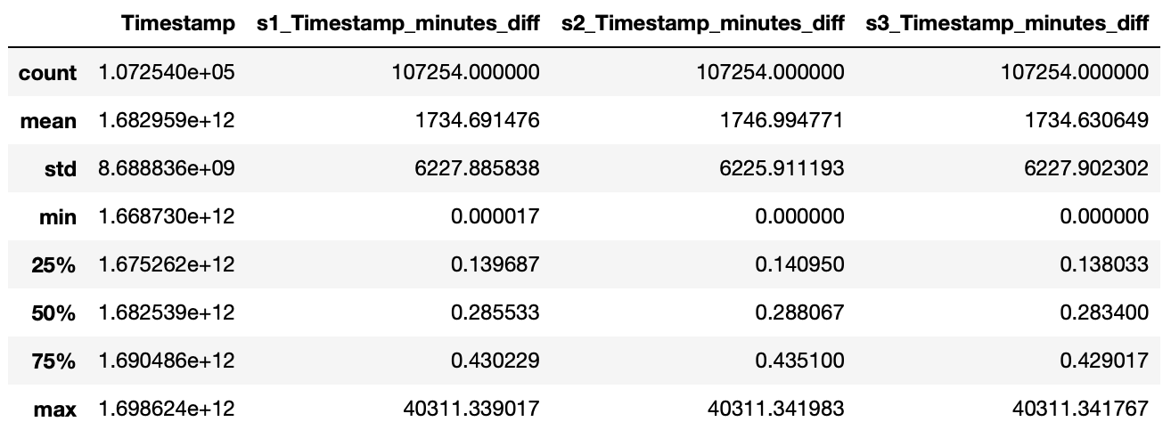
Merging the Vibration Dataset with Machine Status Dataset
s1_m = [f"machine{i}" for i in range(1, 6)]
s2_m = [f"machine{i}" for i in range(6, 14)]
s3_m = [f"machine{i}" for i in range(14, 22)]
def handle_outlier_machine_status(row):
if row["s1_Timestamp_minutes_diff"] > tolerance:
row[s1_m] = 0
if row["s2_Timestamp_minutes_diff"] > tolerance:
row[s2_m] = 0
if row["s3_Timestamp_minutes_diff"] > tolerance:
row[s3_m] = 0
return row
15 min as tolerance

Slide 9
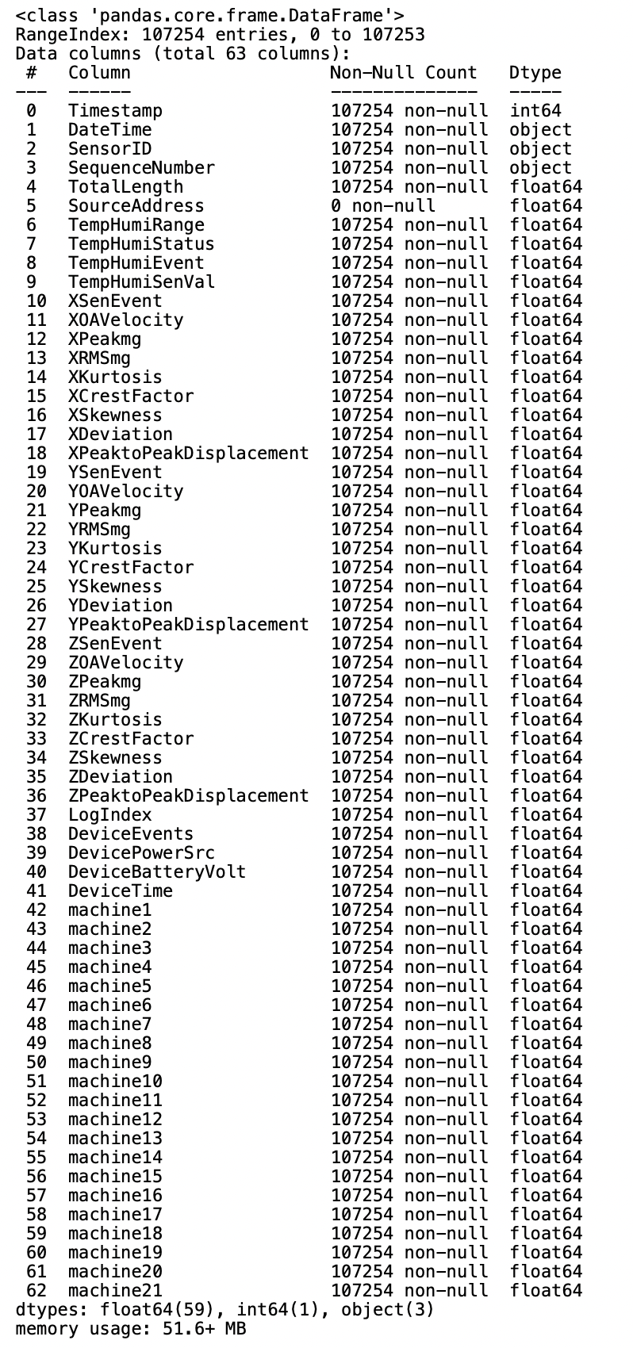
FINAL MERGED DATASET

Slide 10
Exploratory Data Analysis
2

Slide 11
Data Analysis
Analysis was conducted in following approaches.
Null and unique value analysis.
Correlation Analysis
Univariate time series analysis
The dataset consisted of vibration data and machine status data.
Analysis was performed on both types of data.
Null value Analysis
Percentage of null values was calculated and the feature ‘SequenceNumber’ was removed due to having significantly higher null value percentage.

Slide 12
Unique values
Correlation Analysis
Number of unique values were counted for each feature.
This is helpful in determining the values which do not vary across the time.
These values can be neglected when doing time series analysis since there is no change with the time.
Correlation analysis is important in feature selection for modelling as well.
Correlation was checked in vibration data and machine status data separately.

Slide 13
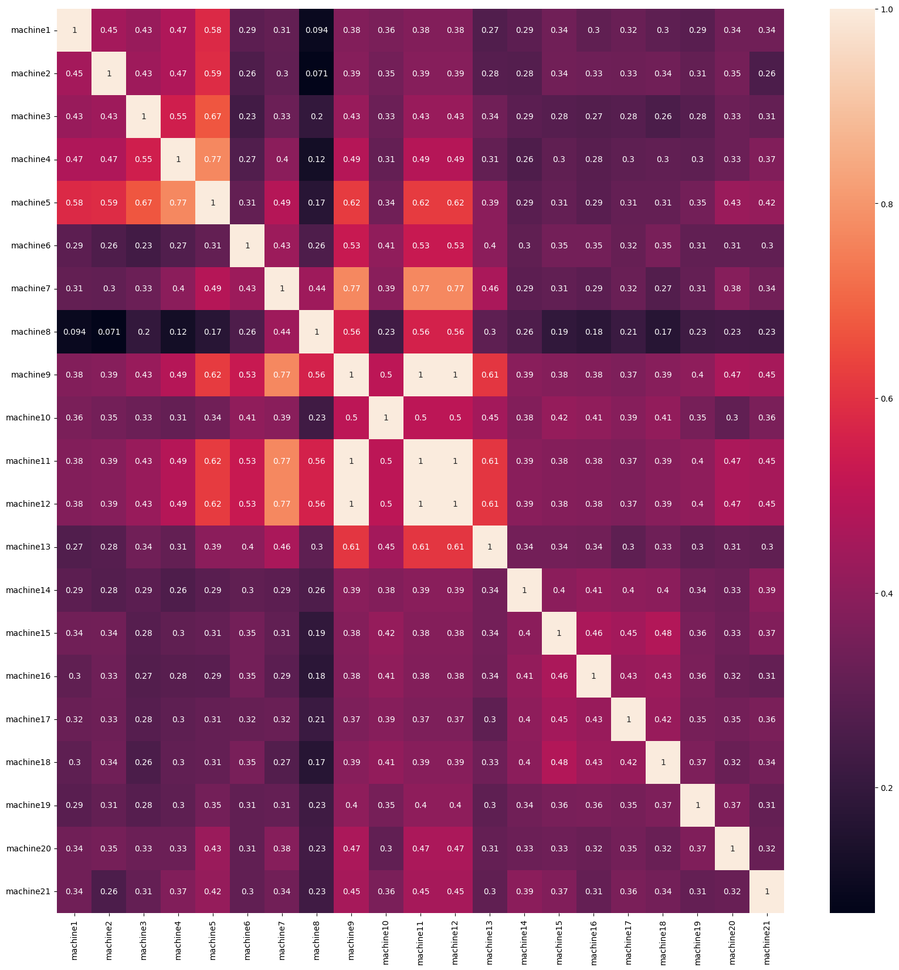
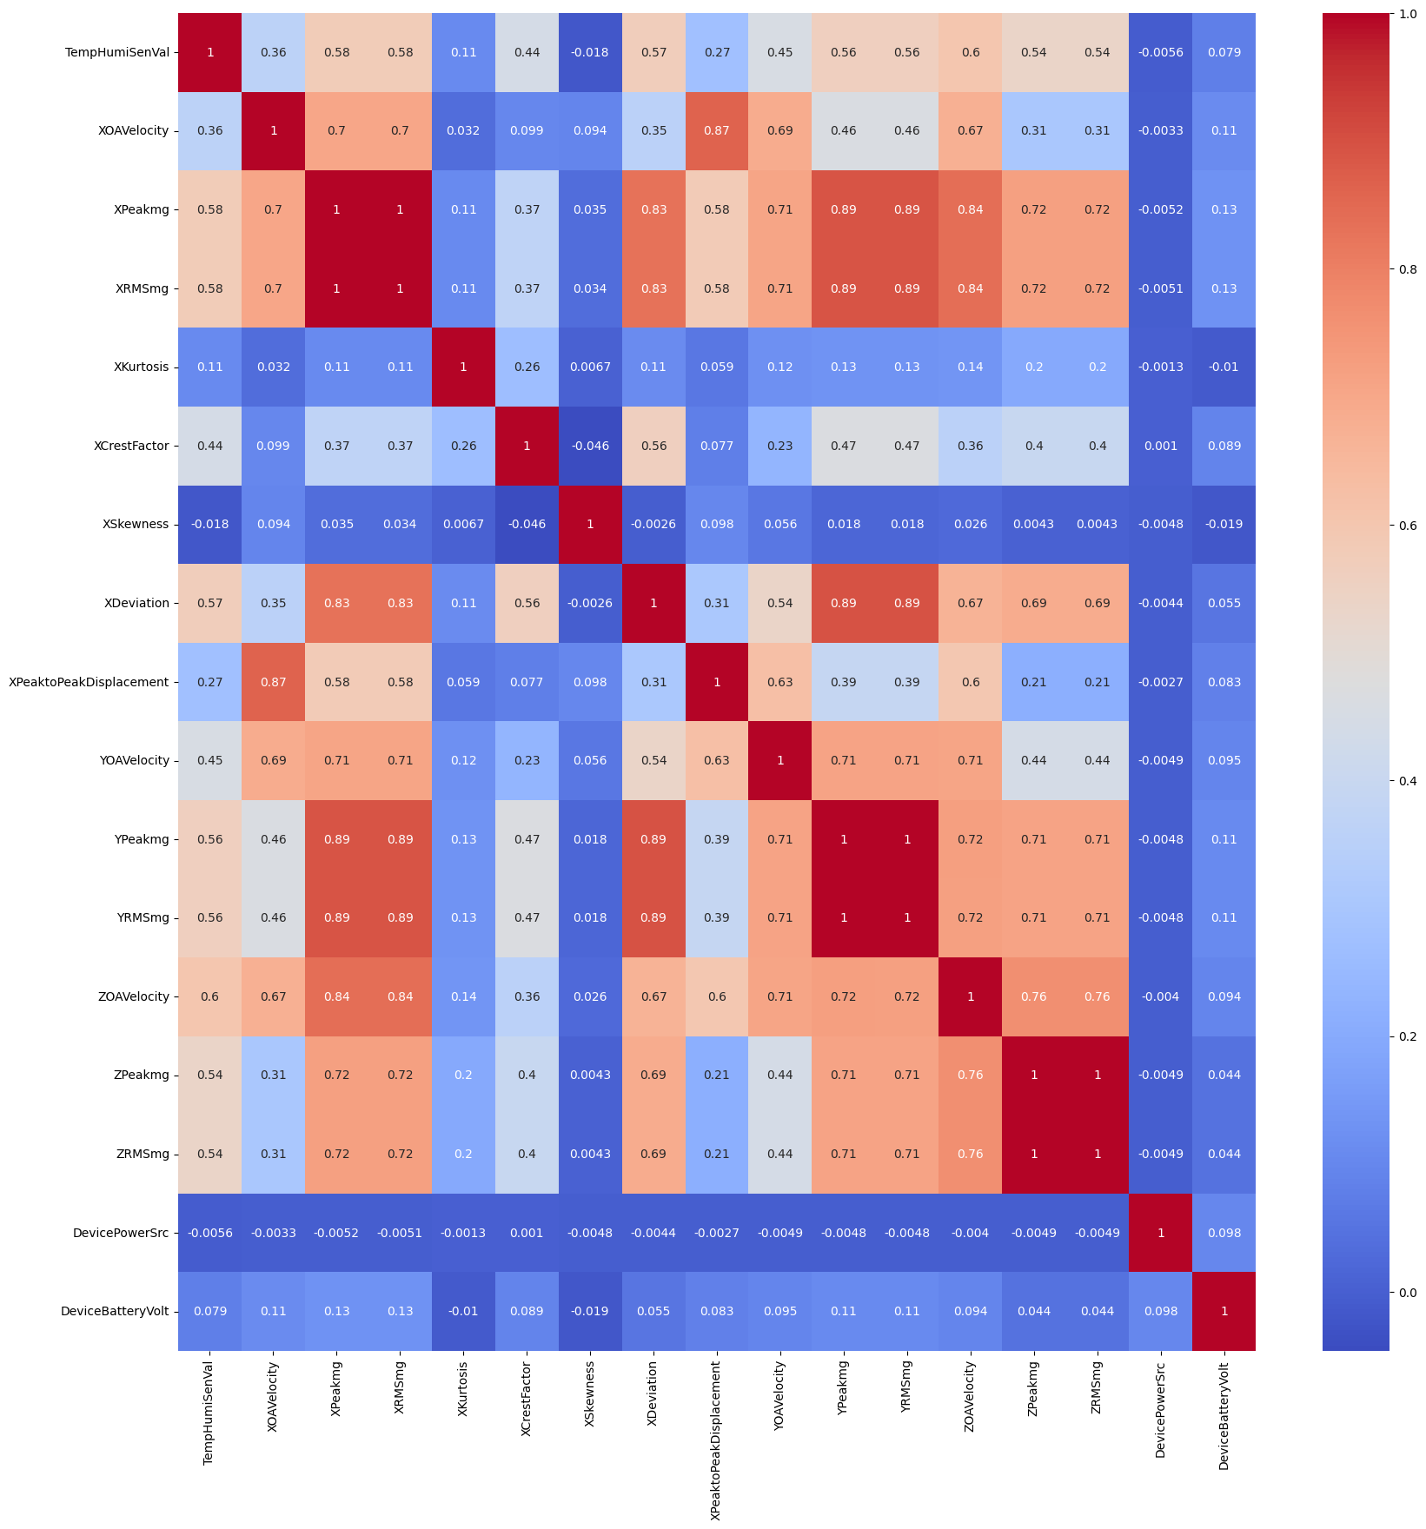

Slide 14
Analysis with machine 2
Different phase of analysis was done taking into account the status of machine 2.
Status of any machine can be one of,
1 : on
0 : off
-1 : unknown
When considering the correlation between vibration data and status of machine 2 following features showed the highest correlation.
ZOAVelocity: 0.630355
XPeakmg: 0.592414
XRMSmg: 0.592159
TempHumiSenVal: 0.58641
ZPeakmg:0.585569

Slide 15
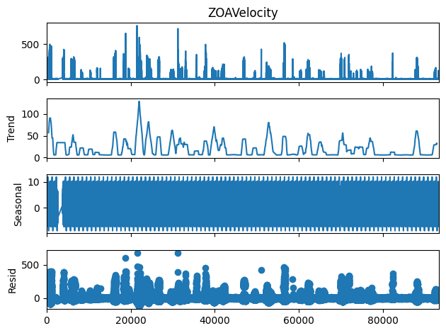
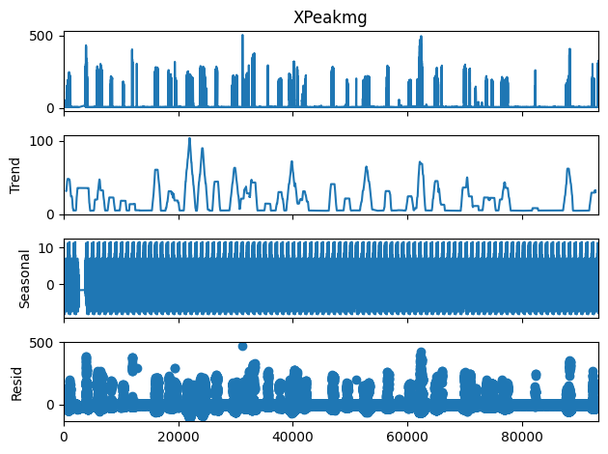

Univariate time series analysis
The selected set of features were further taken into consideration for univariate time series analysis.
Seasonal decomposition was used to decompose the time series data.
The intention of this analysis was to observe trend and seasonality after decomposition.
There were no significant patterns observed in trend and seasonality.

Slide 16
Preparing Machine 2 Dataset including Pure & Noisy Data
3

Slide 17
Data Filtering
Our analysis on machine 2
Machine 2 should be in the “on” (1) mode
Other rows were omitted
Differentiated resulting dataset into
“pure” (only machine 2's vibrations)
“noisy” (affected by other machines)
Created a binary feature called “is_pure” (0 for noisy, 1 for pure data)

Slide 18
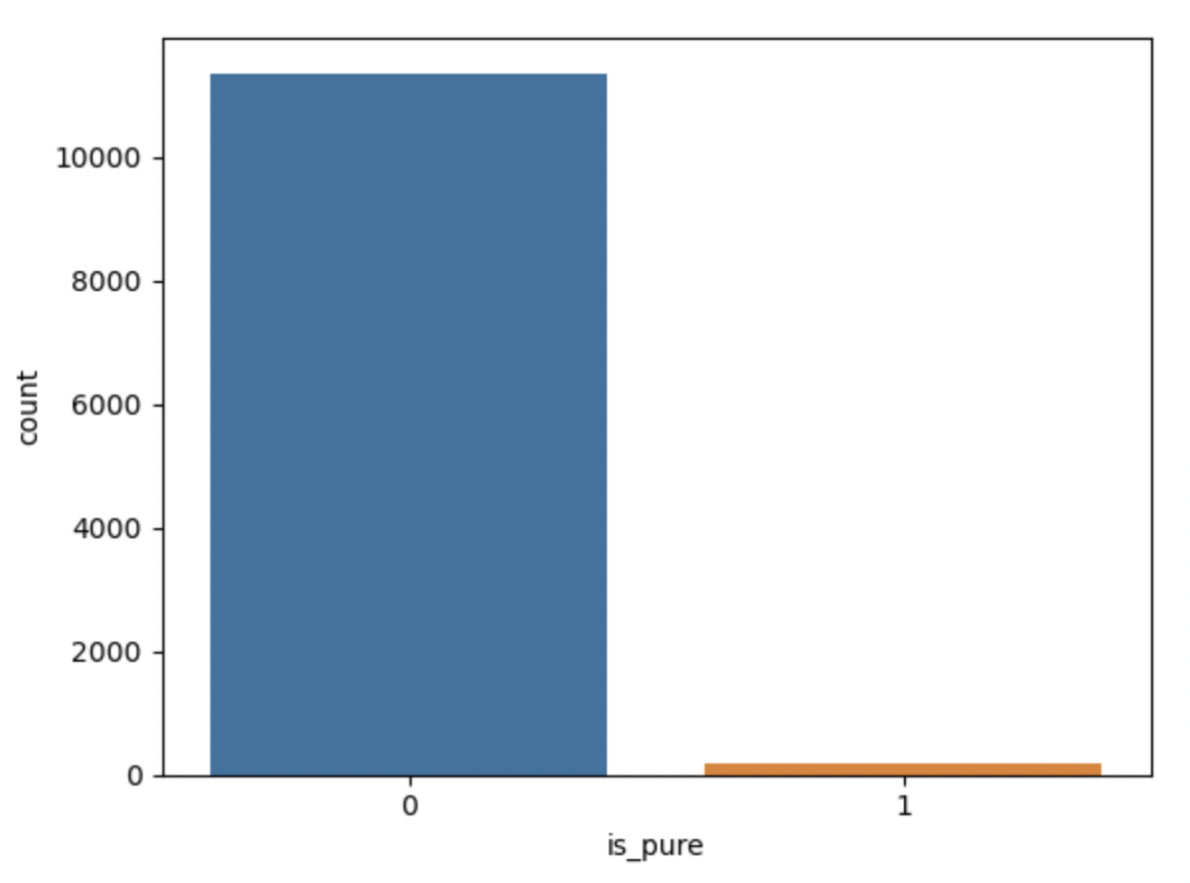
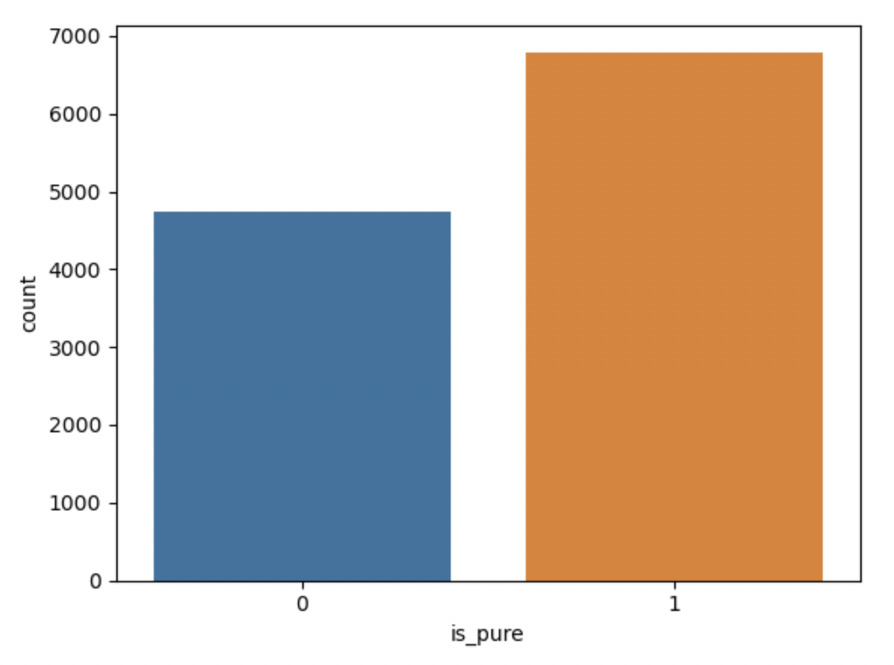
Data Filtering
is_pure = (M2 == 1) & (M1, M3 - M21 == 0)
is_pure = (M2 == 1) & (M1, M3 - M5 == 0)

Slide 19
Assumptions on Data Filtering
Machines 1 to 5 (M1 - M5) are physically close to machine 2 (M2) in the industrial setup. Based on,
Serial number
Same sensor has been used to capture the status of them
When M2 operates, its vibrations are mostly affected by the neighboring machines (M1, M3 - M5) rather than far away machines 6 to 21.
is_pure = (M2 == 1) & (M1, M3 - M5 == 0)

Slide 20
Model Development
4

Slide 21
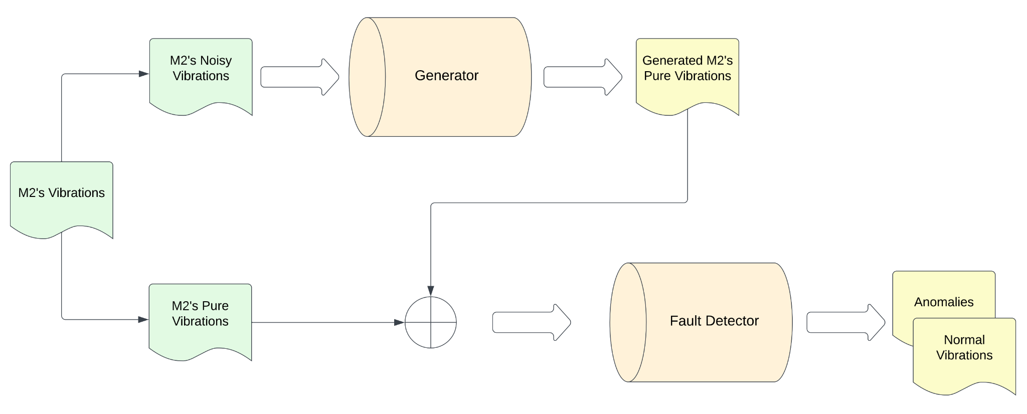
Overview of Model Methodology

Slide 22
Overview of Model Methodology
Discriminator
Generator
Fault Detection

Slide 23
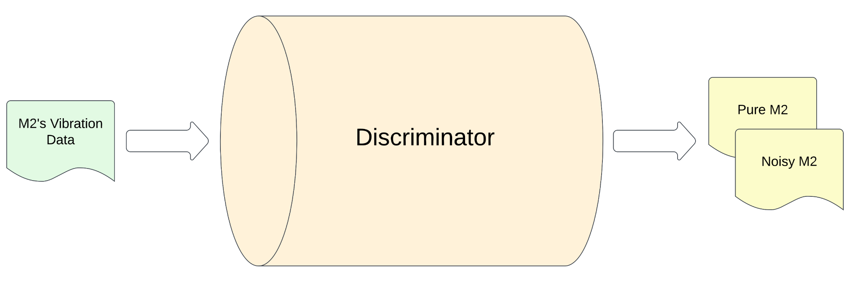
Discriminator Development: Penalizer of Generator
XOAVelocity | XPeakmg | XRMSmg | XKurtosis | XCrestFactor | XSkewness | XDeviation | XPeaktoPeakDisplacement
YOAVelocity | YPeakmg | YRMSmg | YKurtosis | YCrestFactor | YSkewness | YDeviation | YPeaktoPeakDisplacement
ZOAVelocity | ZPeakmg | ZRMSmg | ZKurtosis | ZCrestFactor | ZSkewness | ZDeviation | ZPeaktoPeakDisplacement
One input sample

Slide 24
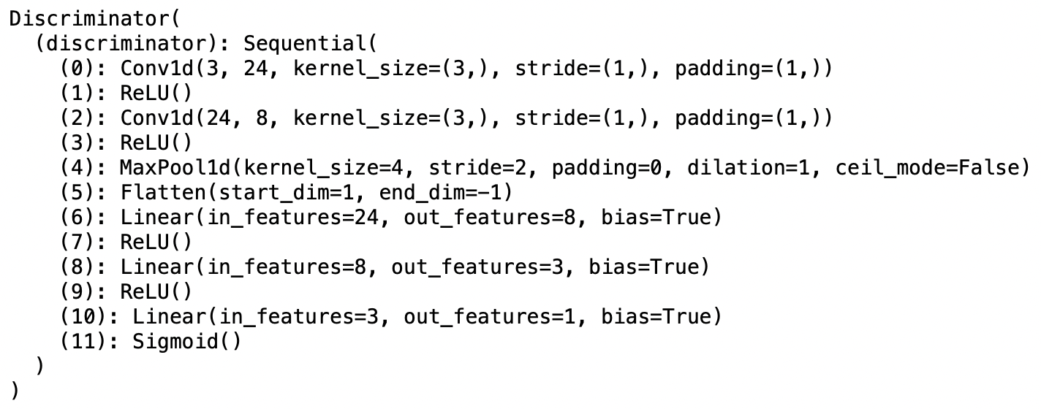
Architecture of Discriminator

Slide 25
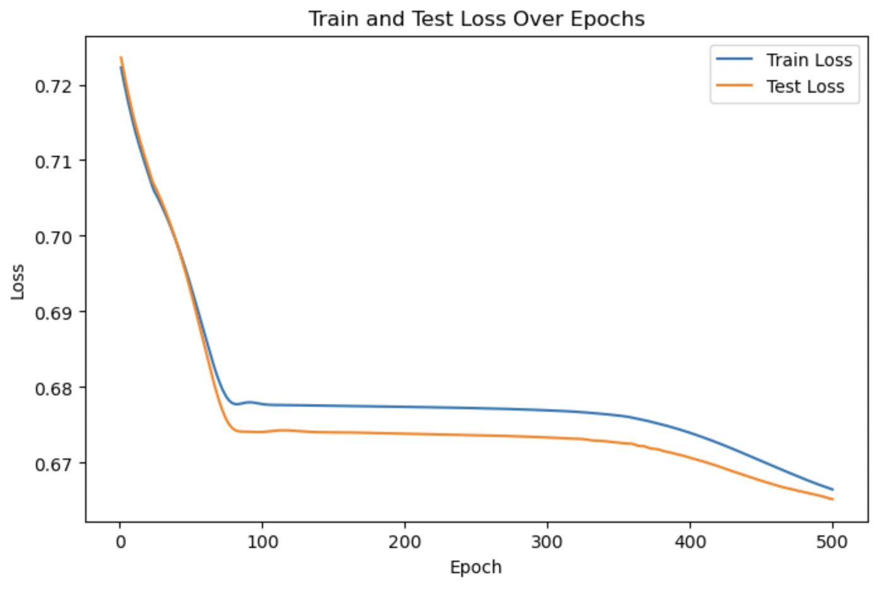
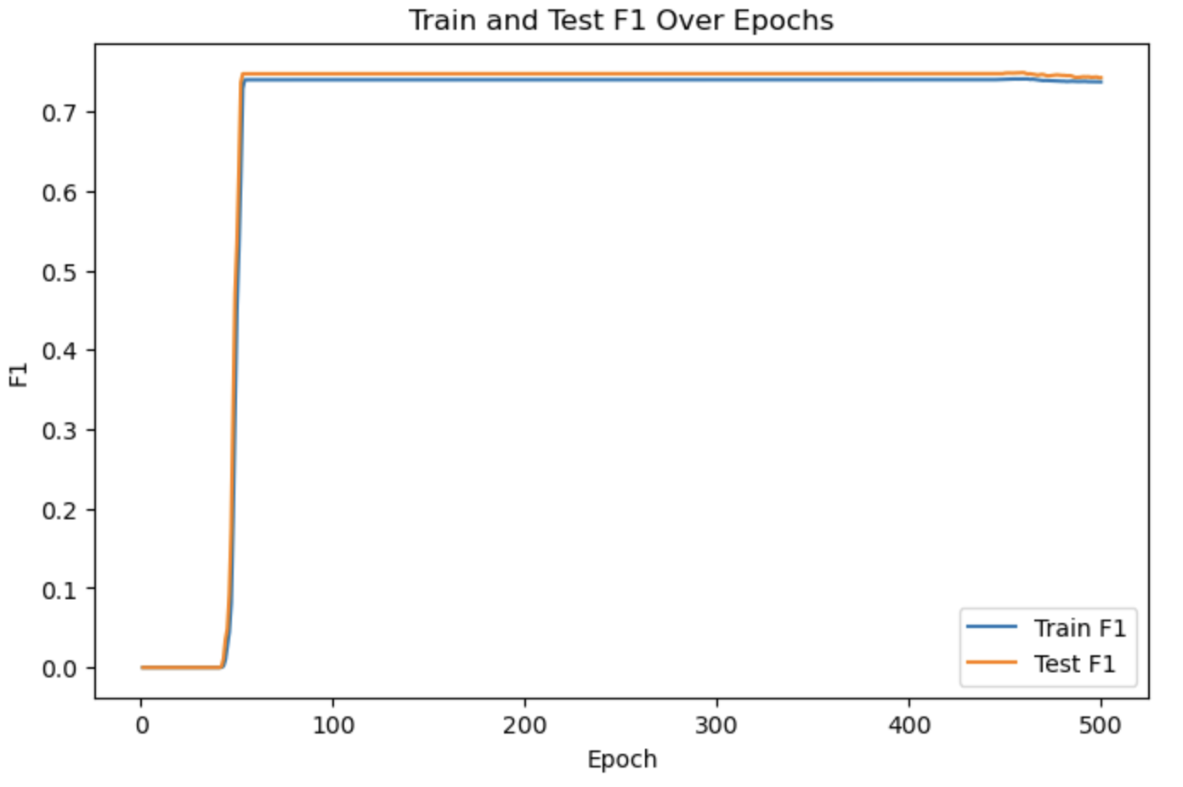
num_epochs = 500, lr = 0.001

Slide 26
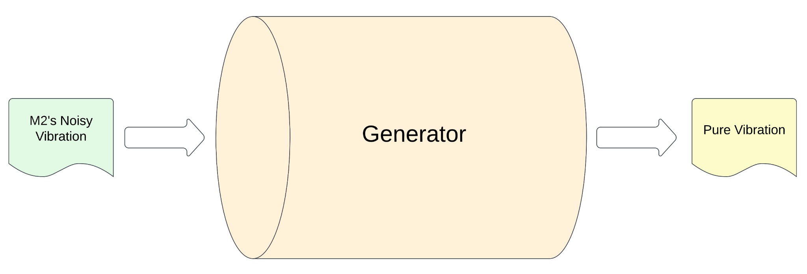
Generator Development
XOAVelocity | XPeakmg | XRMSmg | XKurtosis | XCrestFactor | XSkewness | XDeviation | XPeaktoPeakDisplacement
YOAVelocity | YPeakmg | YRMSmg | YKurtosis | YCrestFactor | YSkewness | YDeviation | YPeaktoPeakDisplacement
ZOAVelocity | ZPeakmg | ZRMSmg | ZKurtosis | ZCrestFactor | ZSkewness | ZDeviation | ZPeaktoPeakDisplacement
One input sample

Slide 27
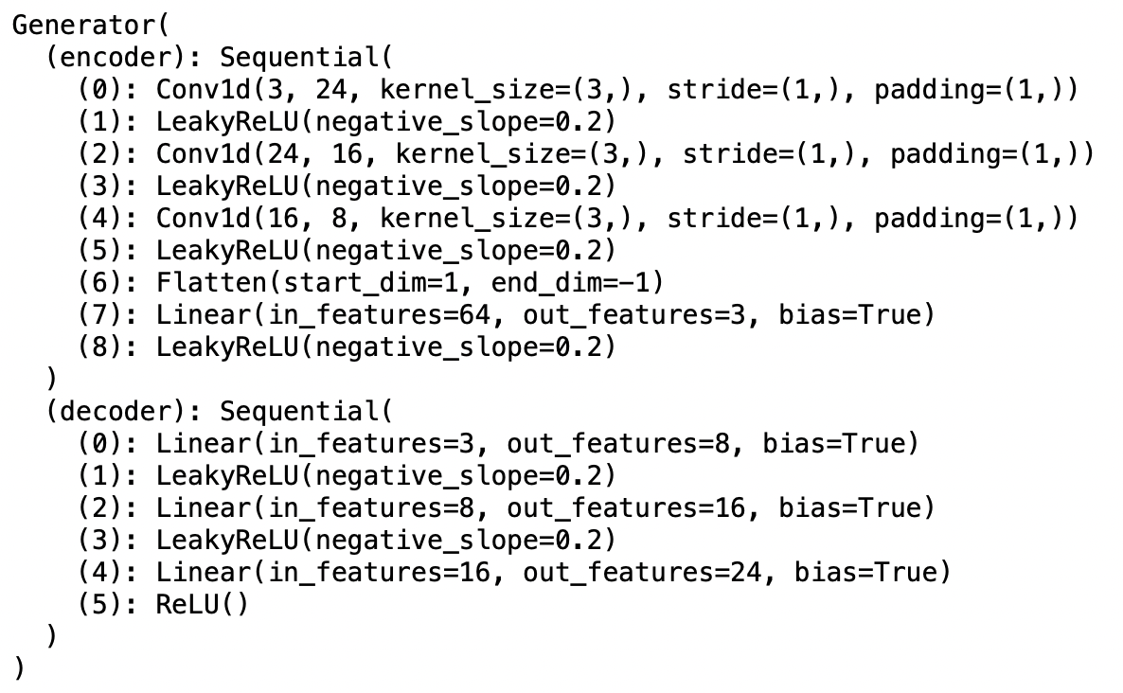
Architecture of Generator

Slide 28
Generator Development
Cost
=
α * [-log(reconstruction_is_pure).mean()]
+
β * MSE(reconstructed_data, original_data)

Slide 29
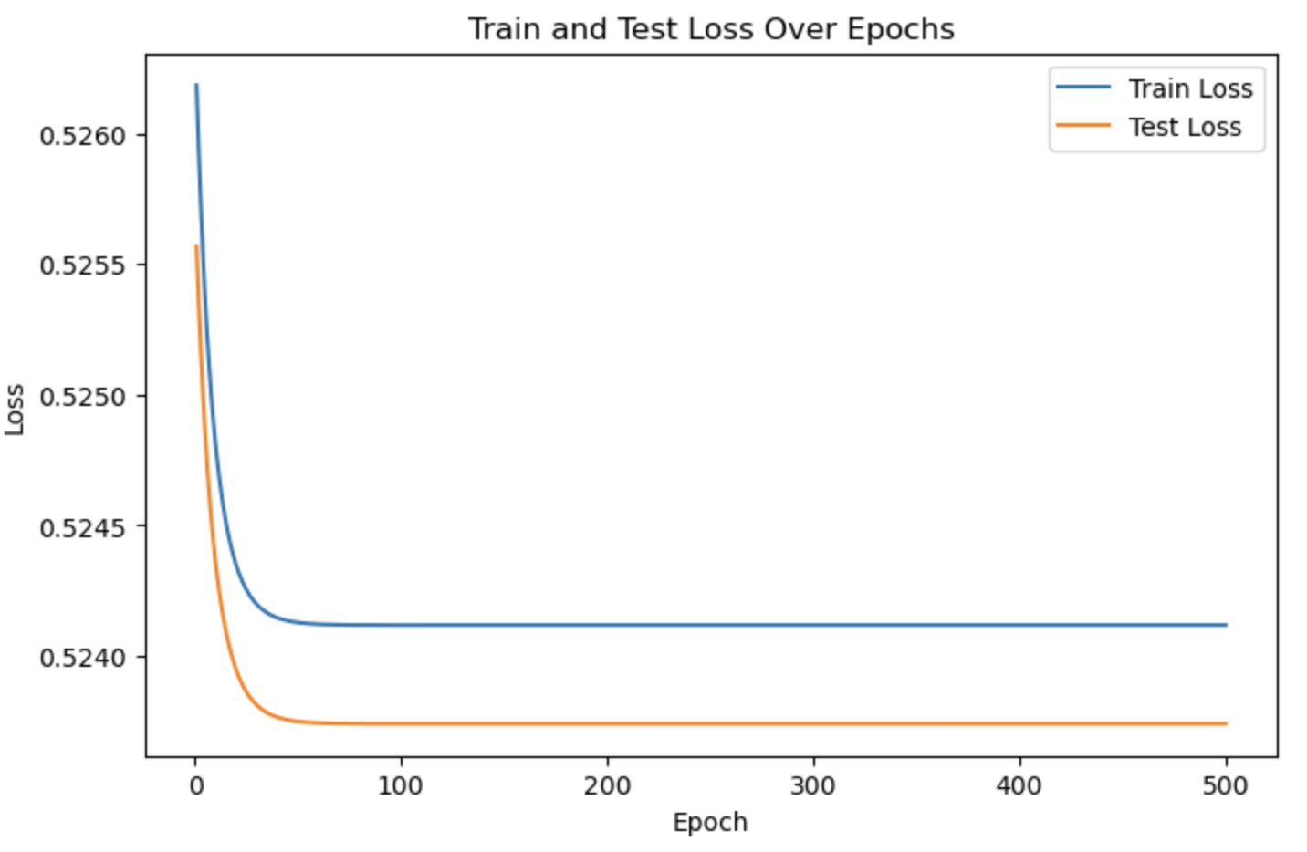
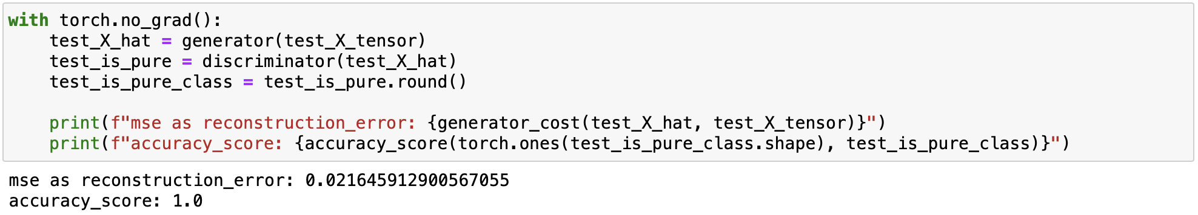
num_epochs = 500, lr=0.001, alpha = 1, beta = 2

Slide 30
Fault Detection
Our project revolves around the core principle of unsupervised anomaly detection.
Dataset lacks predefined labels for normal or anomalous data points, making unsupervised methods a natural choice.
We thoughtfully selected three specific unsupervised approaches:
K-means clustering - Clustering approach
Isolation Forest
One-Class SVM
Anomaly detection approaches

Slide 31
K-Means Clustering: Understanding Faulty States
K-Means clustering, an unsupervised method, is a crucial component of our approach.
K-Means' capability allows us to categorize data into "faulty" and "non-faulty" states without the need for predefined labels.
We used below of them are the selected features,
XOAVelocity, YOAVelocity, ZOAVelocity

Slide 32
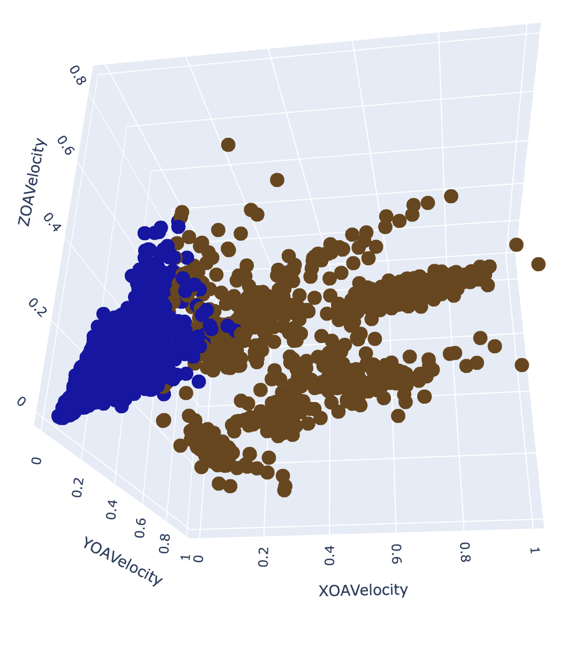
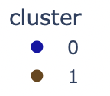
K-Means Clustering

Slide 33
Isolation Forest and One-Class SVM for Anomaly Detection
We used the Isolation Forest and the One-Class Support Vector Machine (SVM) as our next approaches.
These unsupervised techniques excel at identifying anomalies without the need for predefined labels, which is vital for detecting early machine faults.
We used below of them are the selected features,
XOAVelocity, YOAVelocity, ZOAVelocity

Slide 34
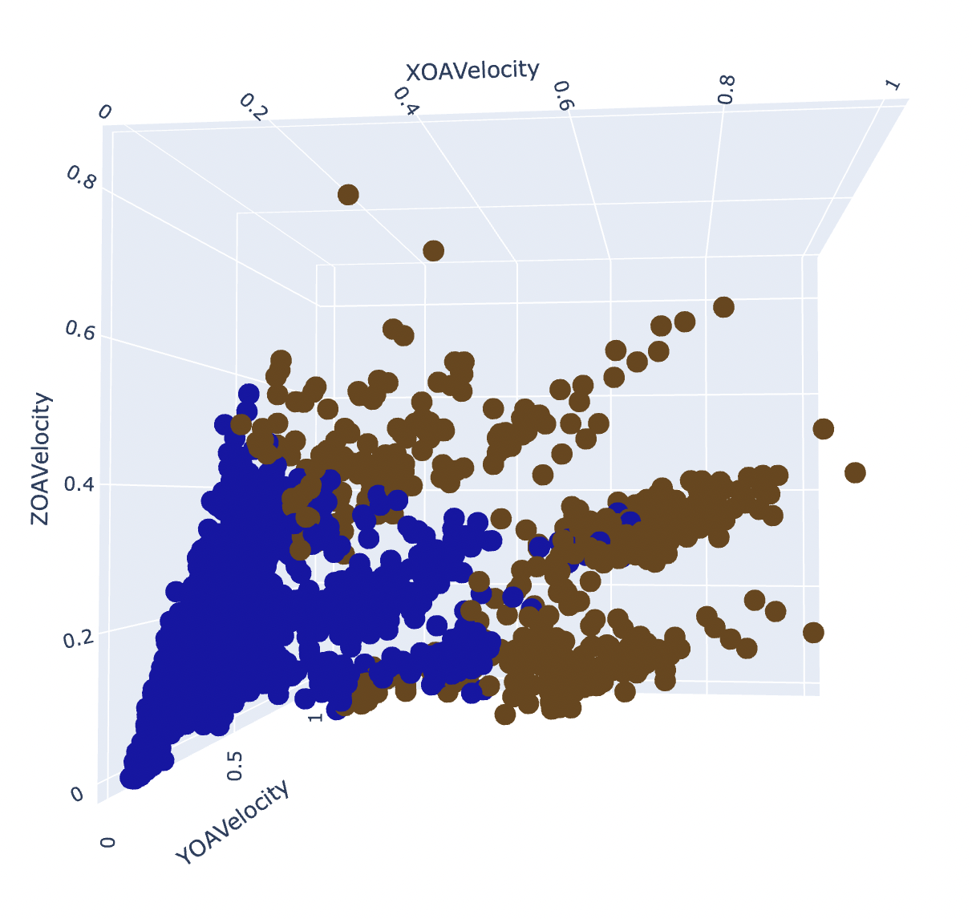
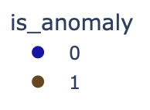
Isolation Forest

Slide 35
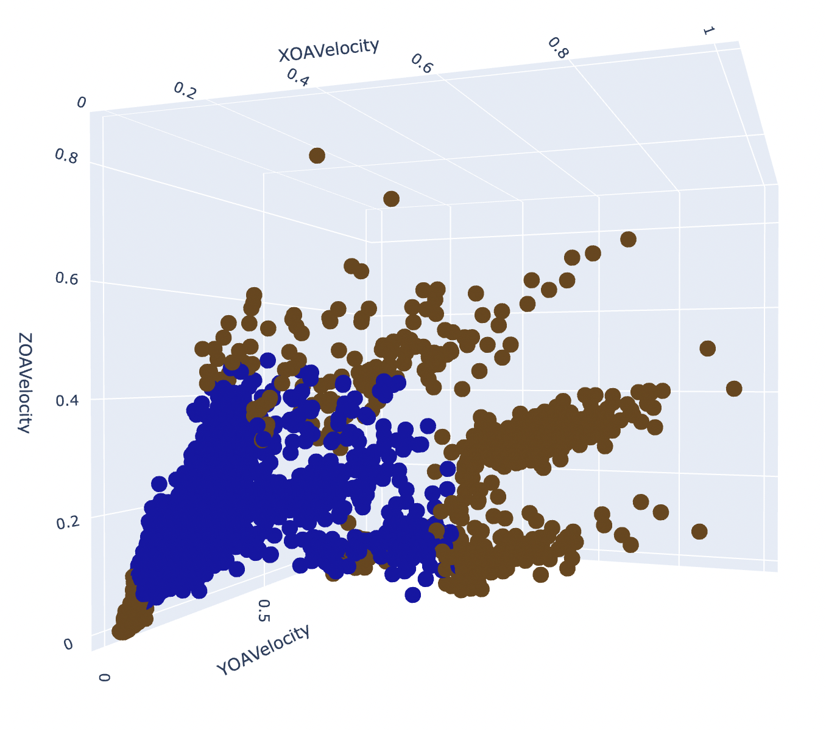
One-Class SVM

Slide 36
Fault Detection
Algorithm | Silhouette Score
K-Means clustering | 0.731
Isolation Forest | 0.727
One-Class SVM | 0.563

Slide 37
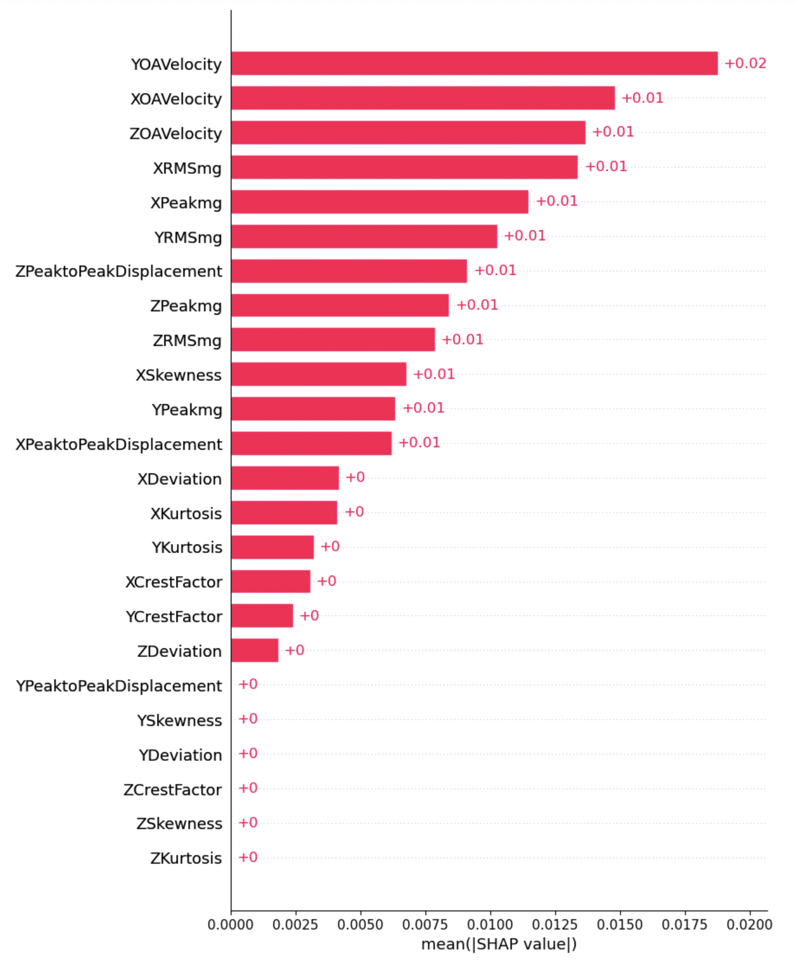
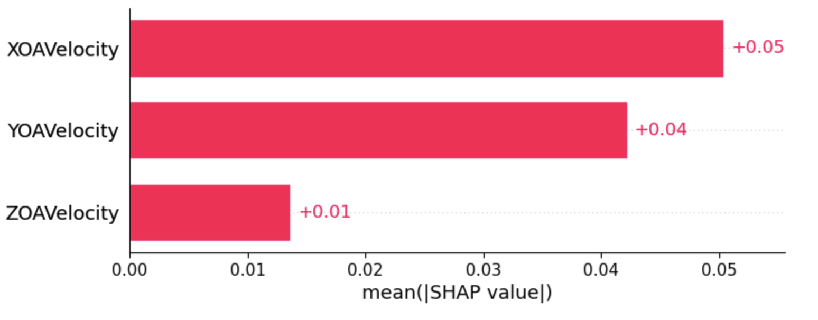
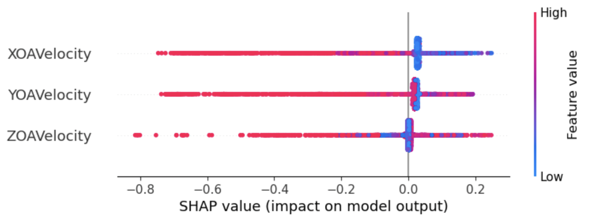
Model Explainability - SHAP

Slide 38
Security & Ethical Consideration
We ensure not to share the data with anyone by signing a nondisclosure agreement.
The machine learning model built for machine 2 has been adhered to all relevant constraints and ethical considerations.
Protect the privacy machine data
Restrict data access and disclose sensitive data only when necessary
To maintain the fairness of the model, the data has been preprocessed with eliminating the bias.

Slide 39
Business Impact
Financial Decision Making
Operational Efficacy
Data-Driven Decision-Making

Slide 40
References
https://youtu.be/ufINa-XGX2M?si=zj3rsVCsiJZMz2-9
https://www.analyticsvidhya.com/blog/2023/01/learning-different-techniques-of-anomaly-detection/
https://www.intellspot.com/anomaly-detection-algorithms/
https://towardsdatascience.com/a-novel-approach-to-feature-importance-shapley-additive-explanations-d18af30fc21b
https://medium.com/analytics-vidhya/anomaly-detection-using-generative-adversarial-networks-gan-ca433f2ac287

Slide 41
THANK YOU!
Any Questions?

